Slide 1
Semantic Segmentation in WSI Analysis
20210525

Slide 2
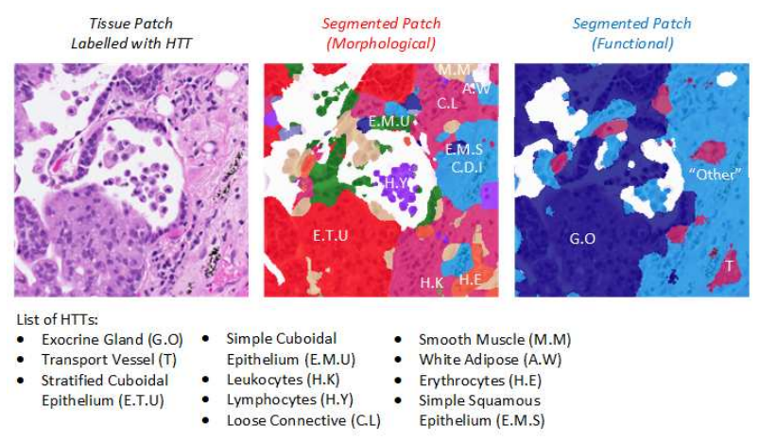
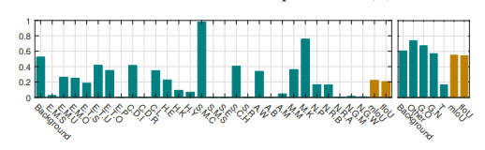
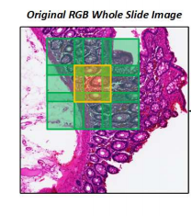
WSI Slide Image
Predicting histopathological tissue type (HTT)
Overlapping slide patches
Functional (mIoU : 0.5505)
Morphological (mIoU : 0.2206)
HistoSegNet: Semantic Segmentation of Histological Tissue Type in Whole Slide Images
Notes:
ca16a5ad-b106-4e84-8a43-178710e854ba.png

Slide 3
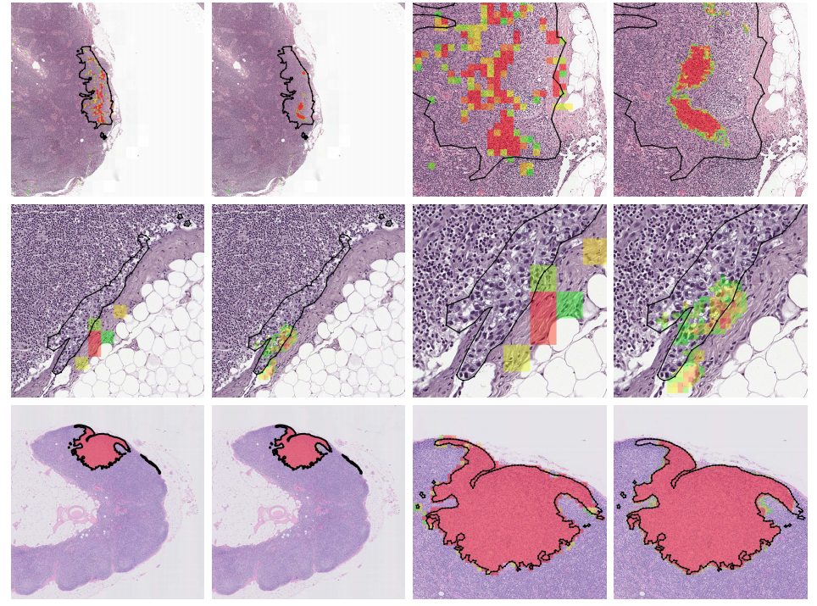
WSI Slide Image
CAMELYON17 challenge dataset – For breast cancer classification
Outlining each lesion in the WSI with polygons
Mostly used dataset
16 > 270 : 129 = train : test
17 > 500 : 500 = train : test
From Detection of Individual Metastases to Classification of Lymph Node Status at the Patient Level: The CAMELYON17 Challenge
Notes:
ca16a5ad-b106-4e84-8a43-178710e854ba.png

Slide 4
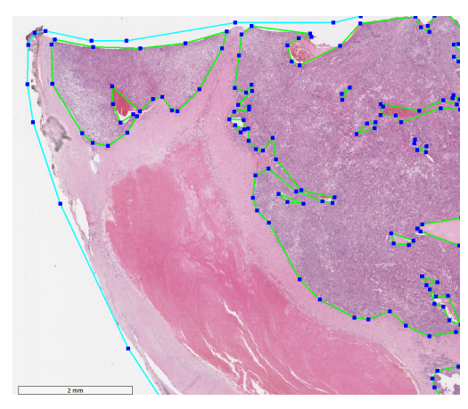
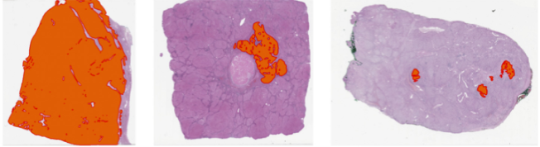
WSI Slide Image
PAIP 2019 : Liver cancer segmentation challenge dataset
Small sized Dataset (50:49=train:test)
PAIP 2019: Liver cancer segmentation challenge
Notes:
ca16a5ad-b106-4e84-8a43-178710e854ba.png

Slide 5
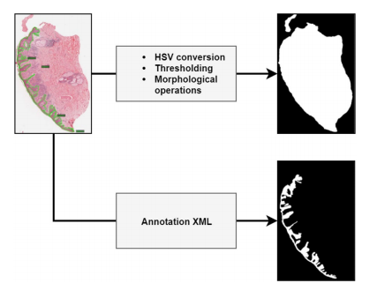
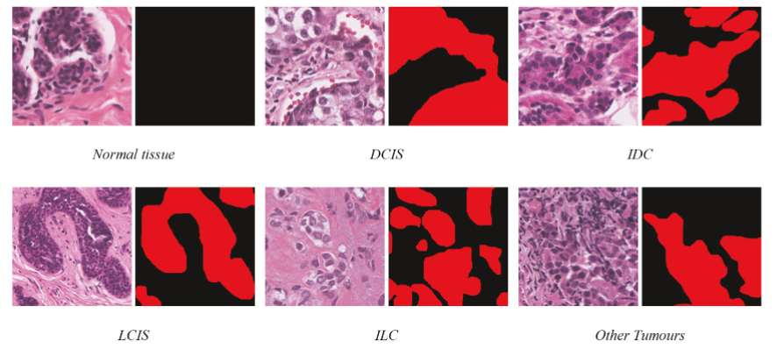
WSI Slide Image
Tumor lesion segmentation
Xception (64.52%), MobileNet (59.72%), ResNet (57.25%)
Automatic segmentation of whole-slide H&E stained breast histopathology images using a deep convolutional neural network architecture
Notes:
ca16a5ad-b106-4e84-8a43-178710e854ba.png

Slide 6
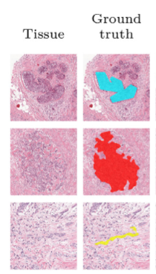
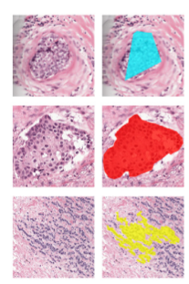
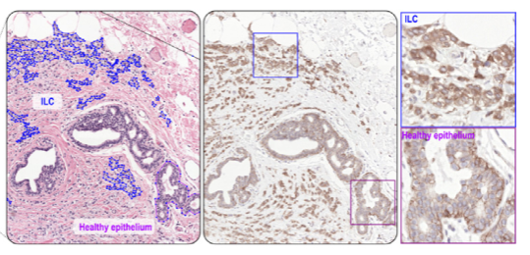
WSI Slide Image
Tumor lesion segmentation
Non-exhaustive : not all instances of that tissue type were annotated
Non-dense : not all pixels belonging to the same instance were included
F1 Score : 0.70-0.73 (Lung), 0.83-0.91 (Breast)
Medical Image Analysis 68 (2021) 101890 Contents lists available at ScienceDirect Medical Image Analysis journal homepage: www.elsevier.com/locate/media HookNet: Multi-resolution convolutional neural networks for semantic segmentation in histopathology whole-slide images
Notes:
ca16a5ad-b106-4e84-8a43-178710e854ba.png

Slide 7
Thank you :-)

